Slide 1
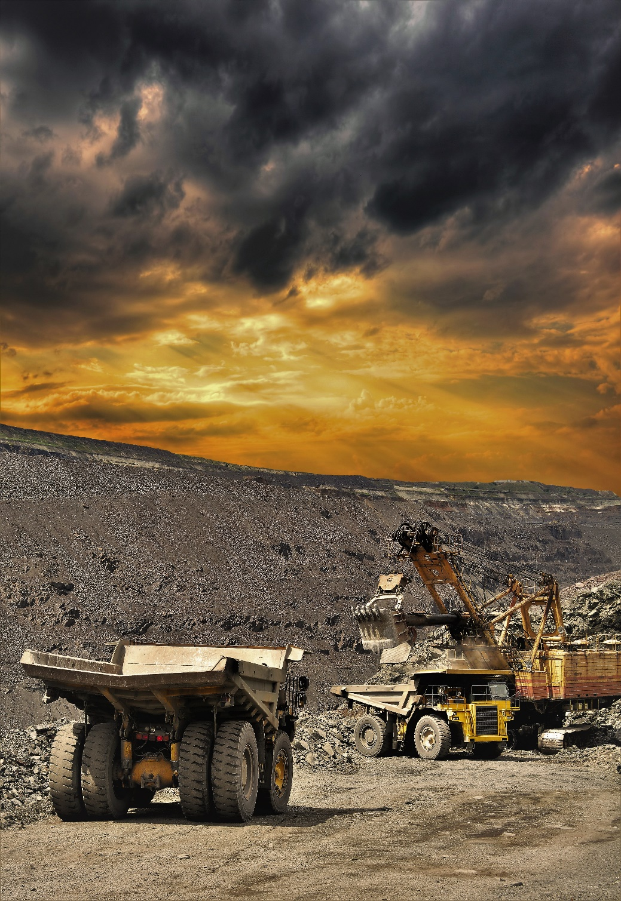
A Day at the Mine

Slide 2
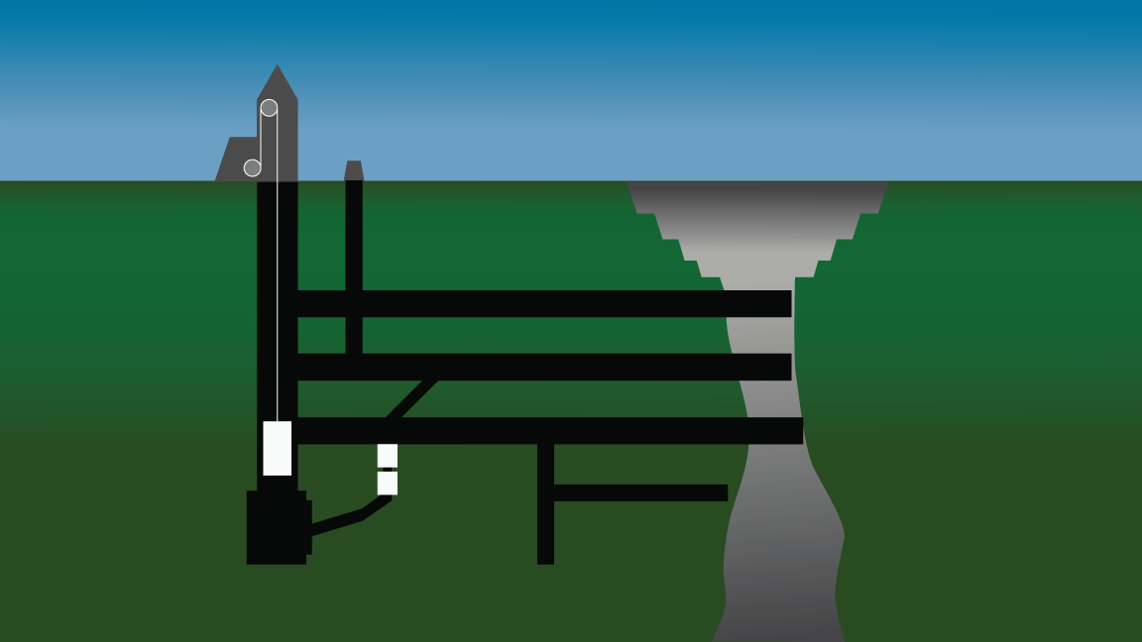
Surface Pit
Underground Workings

Slide 3
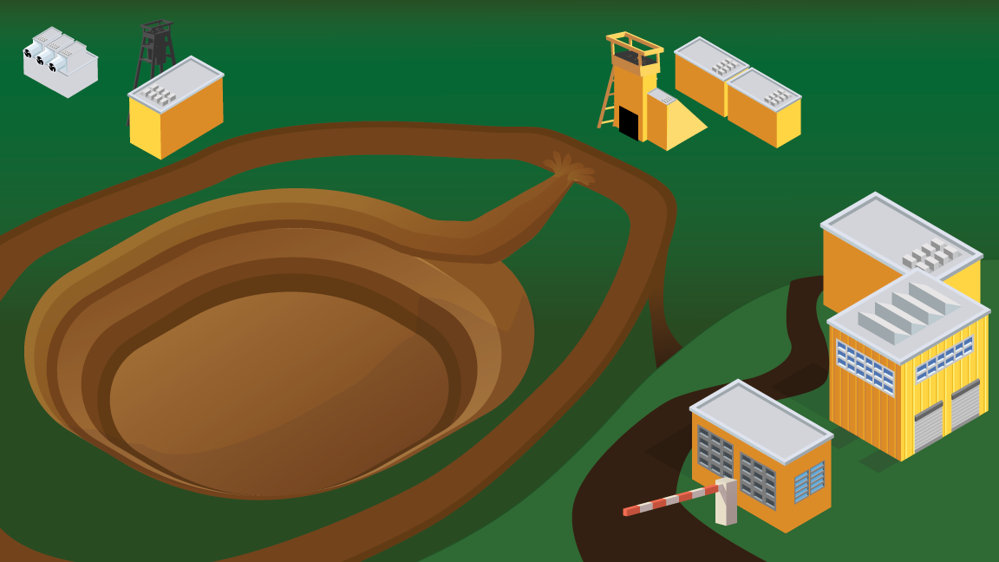
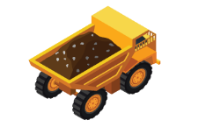
Click on the icons to navigate to the mine area.
Click on the ore cart to return to this screen.

Slide 4
Entering a Mine Site

Slide 5
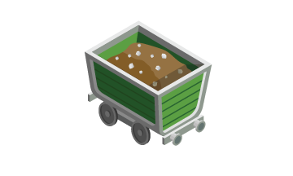

Slide 6
Surface Communication

Slide 8
Surface Transportation

Slide 10
Emergency Evacuation

Slide 12
Surface Ground Control

Slide 14
Explosives

Slide 16
Conveyors

Slide 18
Let’s Go Underground

Slide 20
Underground Ventilation

Slide 22
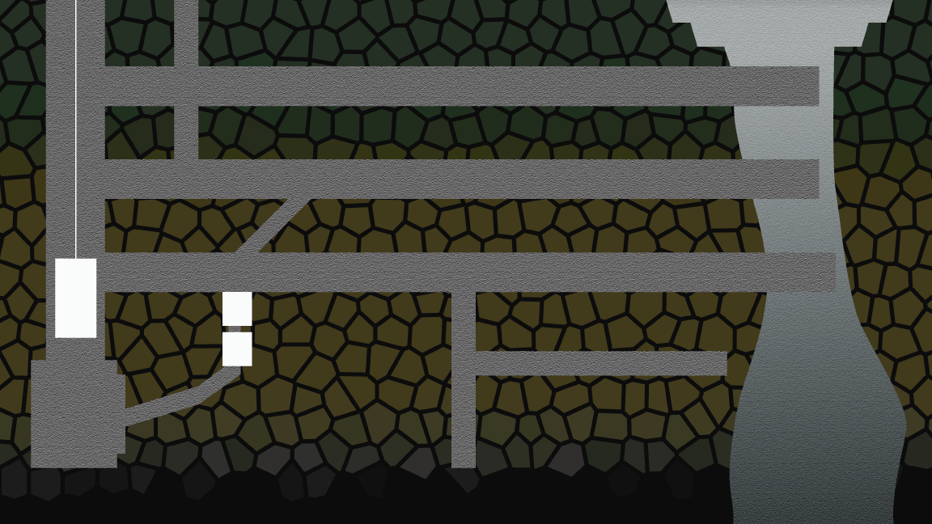
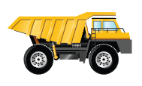
Click on the icons to navigate to the mine area.
Click on the ore cart to return to this screen.

Slide 23
Underground Communication

Slide 25
Underground Transportation

Slide 27
Underground Ground Control

Slide 29
Underground Explosives

Slide 31
Abandoned Areas

Slide 33
Ladderways

